Slide 1
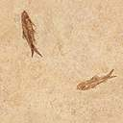


Welcome
Many many greetings to you all.

Slide 2


Teacher and lesson identity
Shahidul Islam
LECTURER IN ENGLISH
DHAKADAKSHIN ML H/S & COLLEGE,SYLHET
01715600555
Unit: 10, Lesson: 02
Dreams

Slide 3

Learning Outcome
At the end of the lesson ss will be able--
Define Dream.
Explain their opinion about dream.
Eescribe the materialistic sight of Dream.

Slide 4
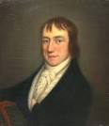
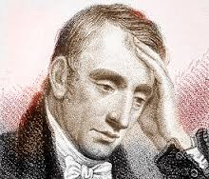
Introduction:
Who is he?
William Wordsworth

Slide 5
William Wordsworth (1770-1850), the great Romantic poet, considered poets dreamers because they have the ability to turn our wish, our power, our thought into “a deed”. Poets give voice to what we desire and strive hard to achieve. They write about the dreams of lovers, men of action, patriots, social reformers, workers and just about anyone given to imagining a better tomorrow for themselves and for others.

Slide 6
In the previous lessons we've learnt about different aspects of dreams.
In this lesson, we will read two poems, written by two poets from two sides of the Atlantic.

Slide 7
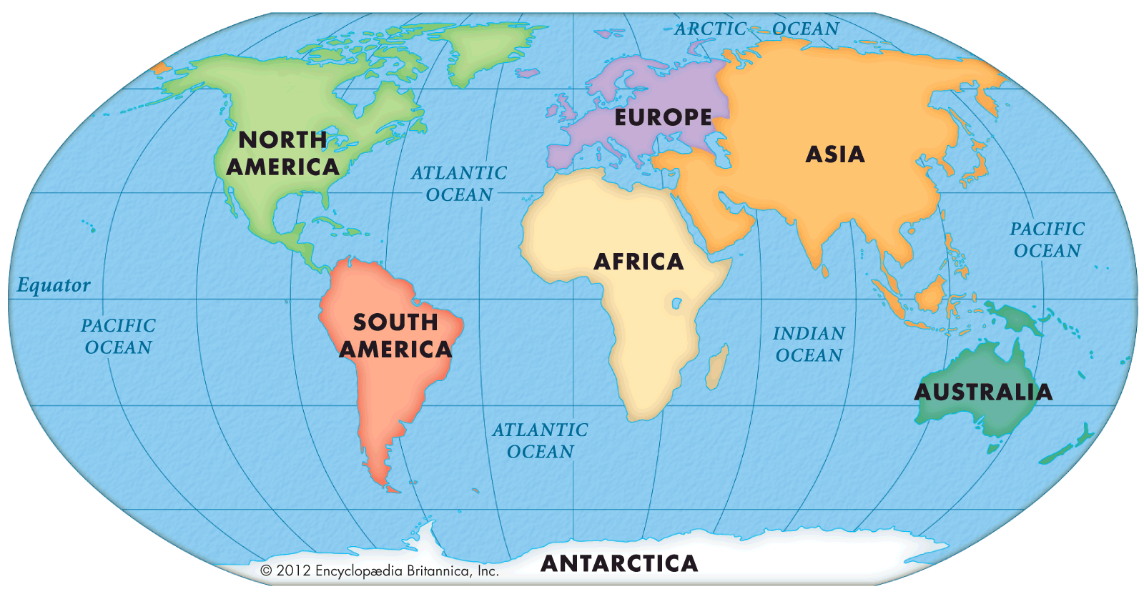

Slide 8
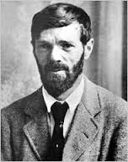
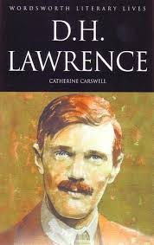
D.H. Lawrence (1885-1930) was an English novelist, poet and essayist.

Slide 9
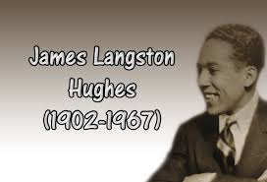
Langston Hughes (1902-1967) was an American poet, novelist and playwright.

Slide 10
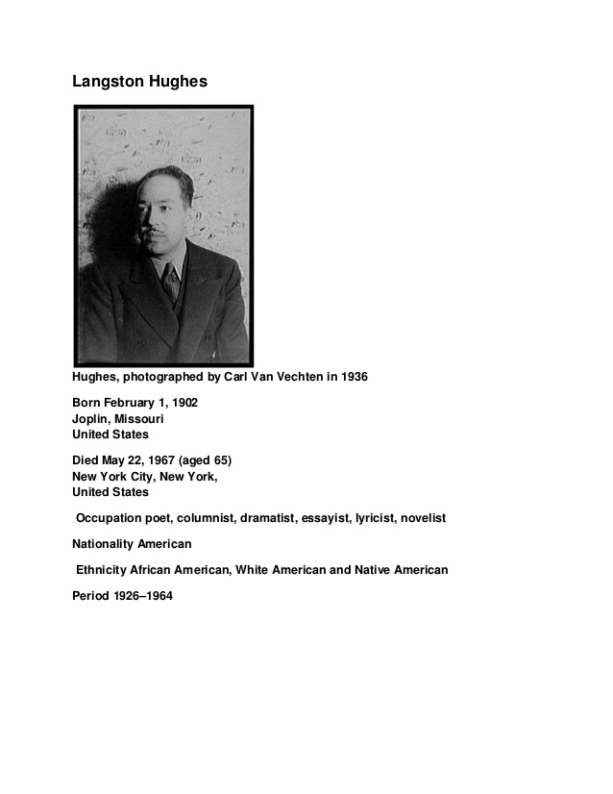
More about Hughes

Slide 11
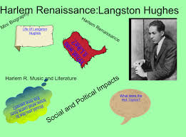
Hughes was also a leader of the Harlem(a district in New York City, north of 96th Street in northeastern Manhattan. It has a large black population and in the 1920s and 1930s was noted for its nightclubs and jazz bands) Renaissance which attempted to bring changes in the lives of the Black people in the 1920s.

Slide 12
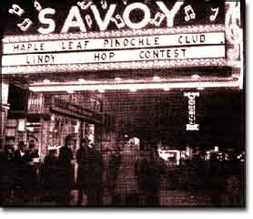
The Harlem Renaissance
The Savoy Ballroom in Harlem in 1926 was The Place and Lindy Hop was The Dance!
It was time for a cultural celebration. African Americans had endured centuries of slavery and the struggle for abolition. The end of bondage had not brought the promised land many had envisioned. Instead, white supremacy was quickly, legally, and violently restored to the New South, where ninety percent of African Americans lived. Starting in about 1890, African Americans migrated to the North in great numbers. This Great Migration eventually relocated hundreds of thousands of African Americans from the rural South to the urban North. Many discovered they had shared common experiences in their past histories and their uncertain present circumstances. Instead of wallowing in self-pity, the recently dispossessed ignited an explosion of cultural pride. Indeed, African American culture was reborn in the Harlem Renaissance.

Slide 13
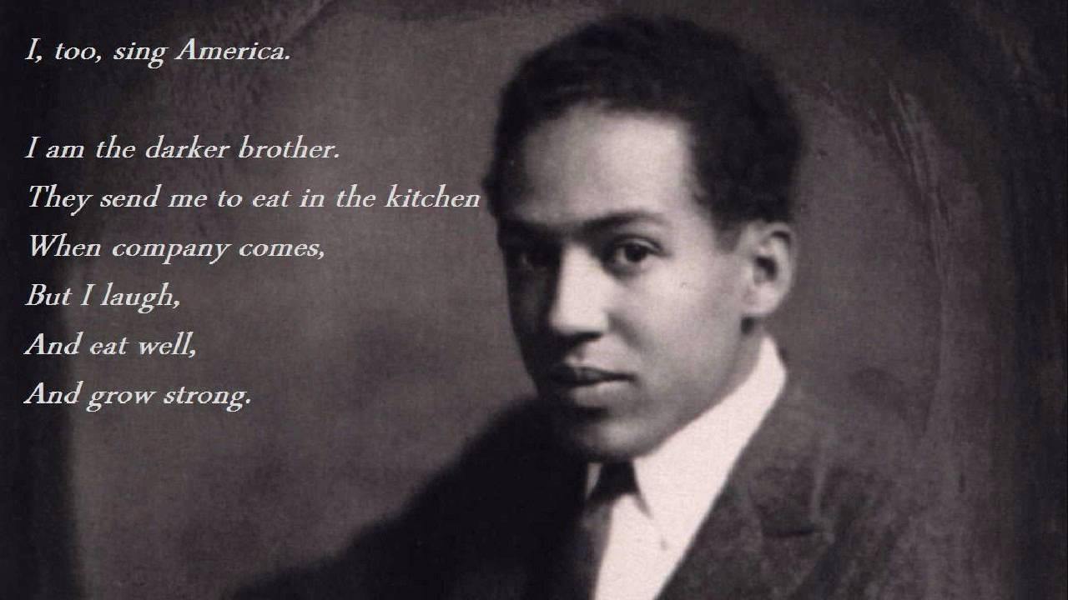

Slide 14
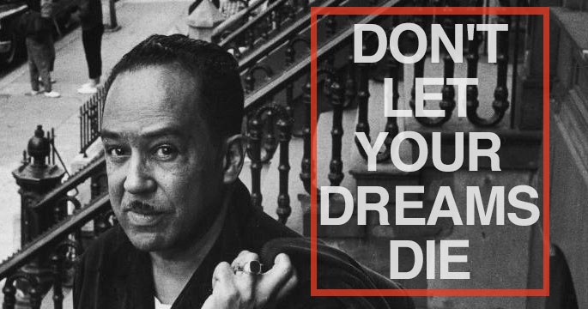

Slide 15
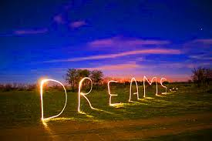
2. Now read the two poems and answer the questions that follow.
Dreams
by D. H. Lawrence

Slide 16
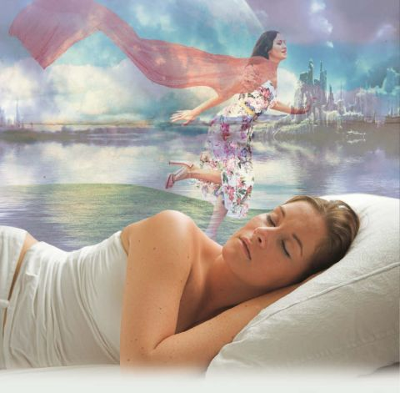
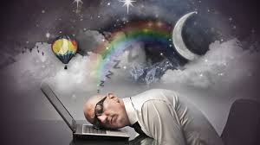
Night
Dream
All people dream, but not equally.
Those who dream by night in the dusty recesses of their mind,
Wake in the morning to find that it was vanity.

Slide 17
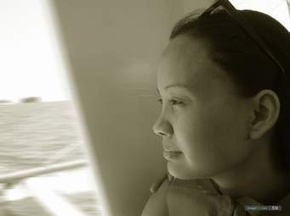
But the dreamers of the day are dangerous people,
For they dream their dreams with open eyes,
And make them come true.

Slide 18
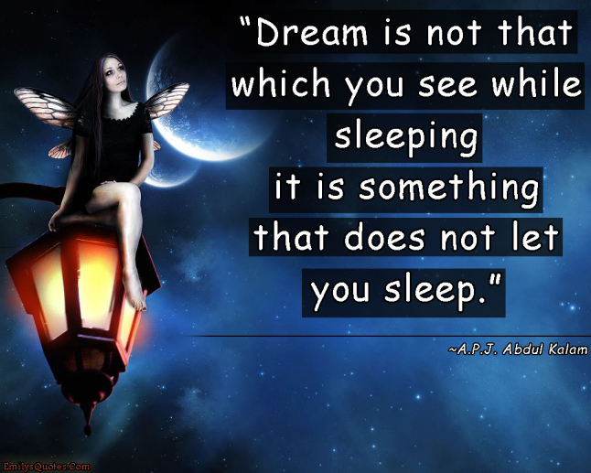

Slide 19
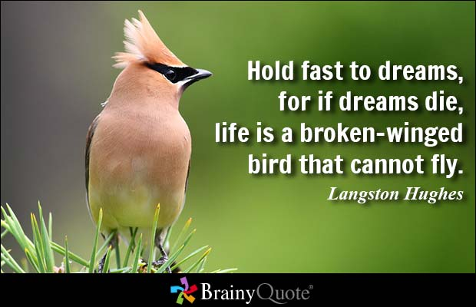
Dreams

Slide 20
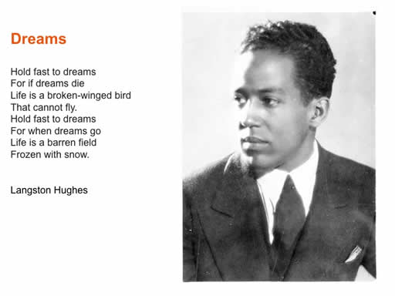

Slide 21
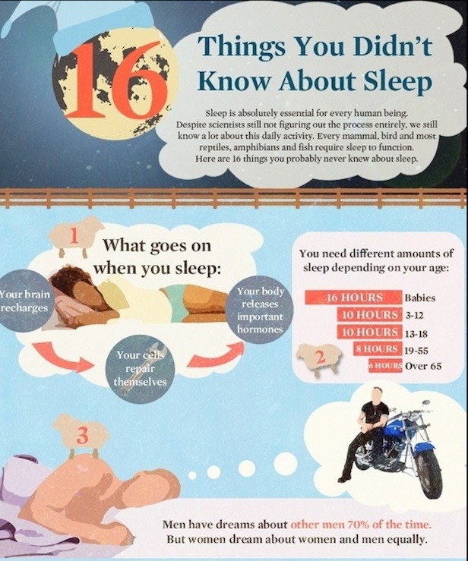

Slide 22
3. Answer the following questions:
a. What type of dreams is Lawrence referring to in his poem?
b. Why does he consider them dangerous?
c. What is the meaning of Dreaming with open eyes?
d. What is Hughes telling his readers to do?
e. Why does he want his readers to hold fast to their dreams?
f. Why, according to Hughes, are dreams so important in our lives?
g. What type of dreams do the two poets highlight?

Slide 23

Individual works
What are the meanings of the following words and phrases?
a. a broken-winged bird
b. barren field
c. frozen
d. recesses of the mind
e. dusty
f. make something come true
g. vanity

Slide 24
Group works
Discuss with your friends and find out what parts of speech are the following words?
a. fast
b. winged
c. snow
d. equally
e. vanity
f. true

Slide 25
a. fast(adj)
b. Winged
(adj)
c. Snow
(adj)
d. Equally
(ad)
e. vanity(n)
f. True
(adj)
PARTS OF SPEECH

Slide 26


Home Work
6. Write a summary of both the poems in 150 words each.

Slide 27



